Slide 1
T-test

Slide 2
overview
What a t-test is and when to use it?
What types of t-test there are
What the hypothesis and the assumptions are
How a t-test is calculated
How to interpret the result

Slide 3
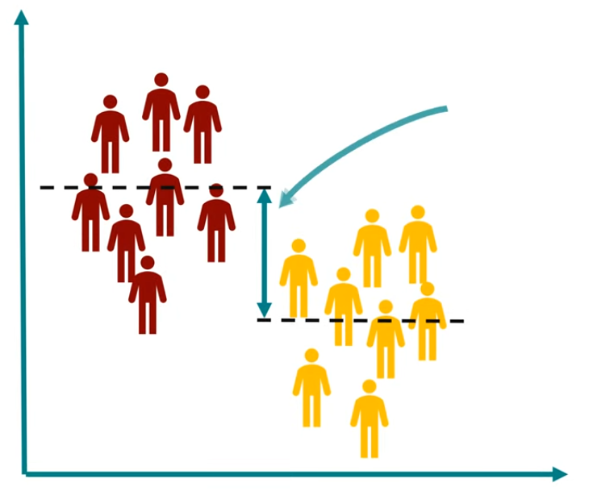
What is a t-test
Statistical test procedure
Difference between the means

Slide 4
Suppose there was two groups of patents, with different drugs.
Now we want to know if there is difference in blood pressure between these two groups

Slide 5
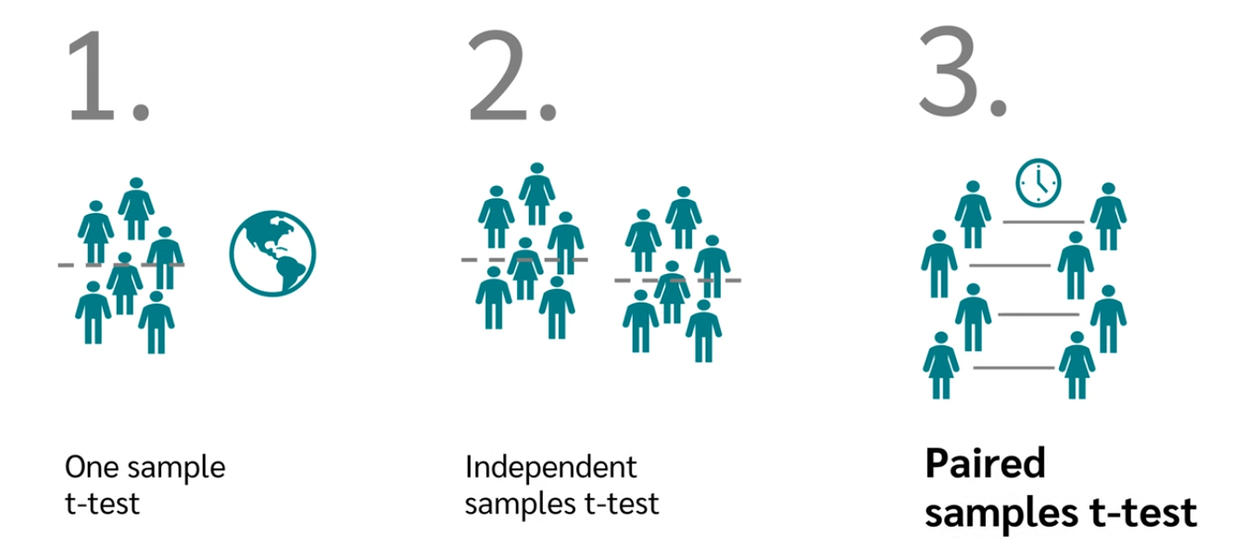
Types of t-test

Slide 6
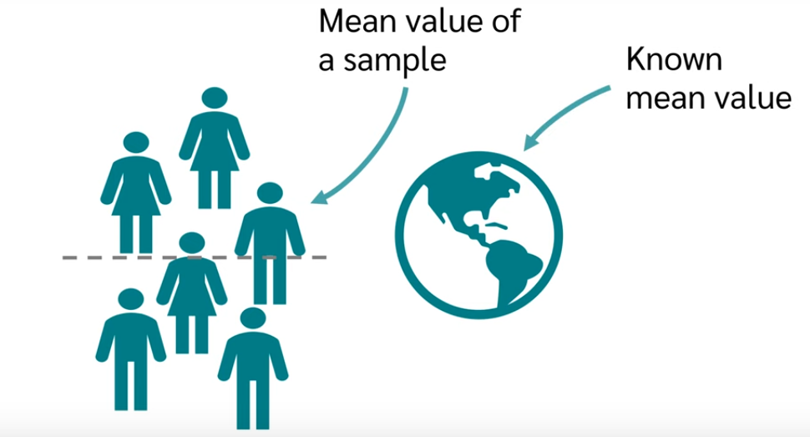
Compare the mean value of the sample with a reference mean value

Slide 7

example
Average: 1000 g
Factory claim:

Slide 8
We can test the claim
Take 30 of them and weight

Slide 9
Mean value
995 grams

Slide 10
Mean value
995 grams
Use t-test
To see if the difference
Is significant from the claim

Slide 11
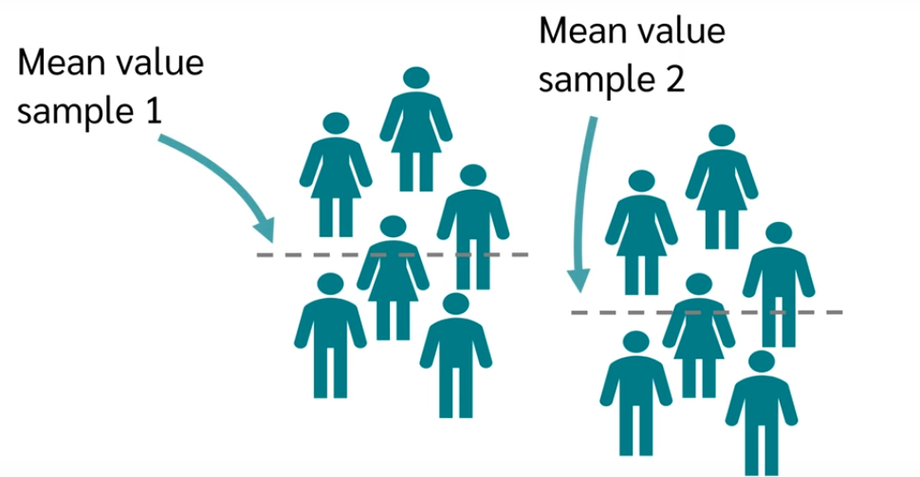

Slide 12
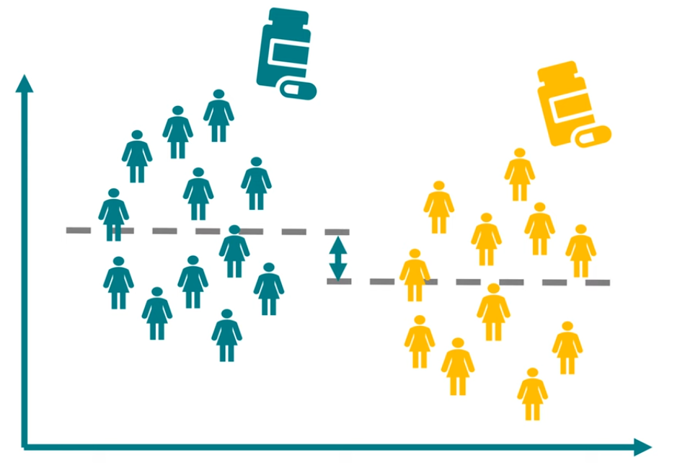
Significance difference of two pain relief

Slide 13
One sample measured at different time

Slide 14

How effective is a diet?

Slide 15
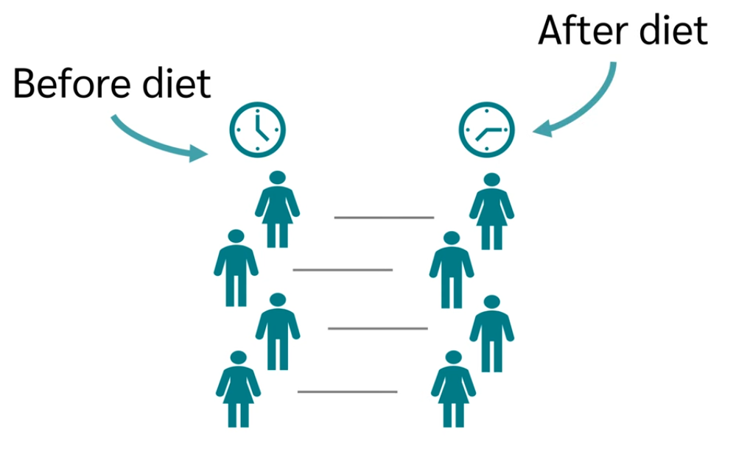

Slide 16
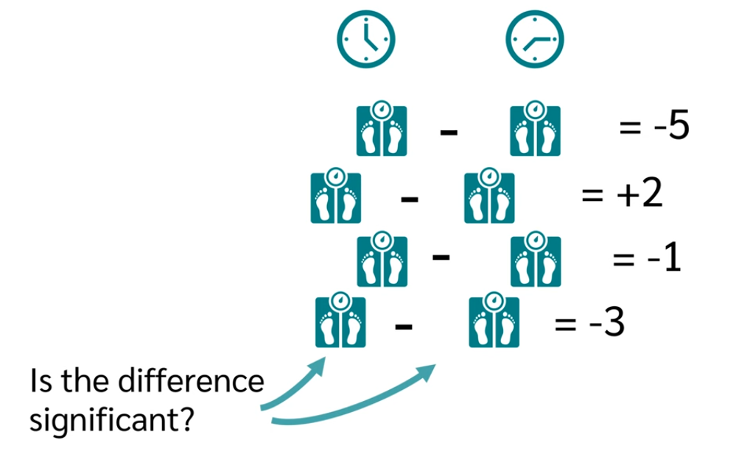

Slide 17
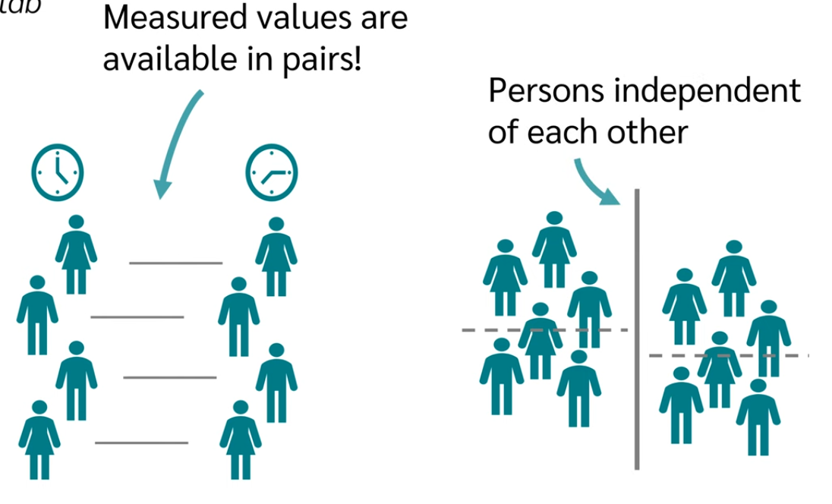
After measuring for different people, we check the difference for different independent people

Slide 18
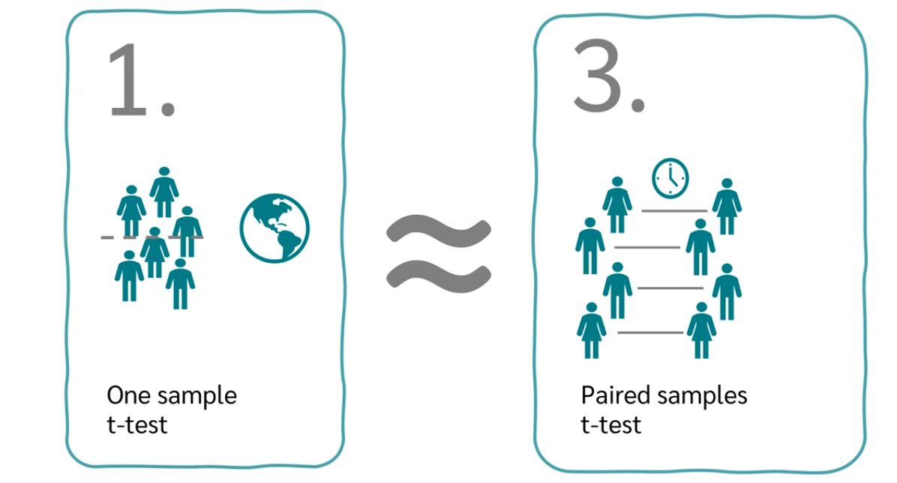
Note: we can see a paired one as a one sample

Slide 19
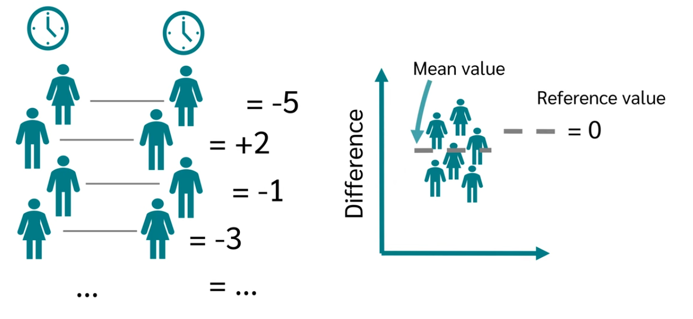
After calculating the difference and calculating the mean we check if it deviate from a reference mean value, exactly like the one sample t-test

Slide 20
What are the assumptions for a t-test?

Slide 21
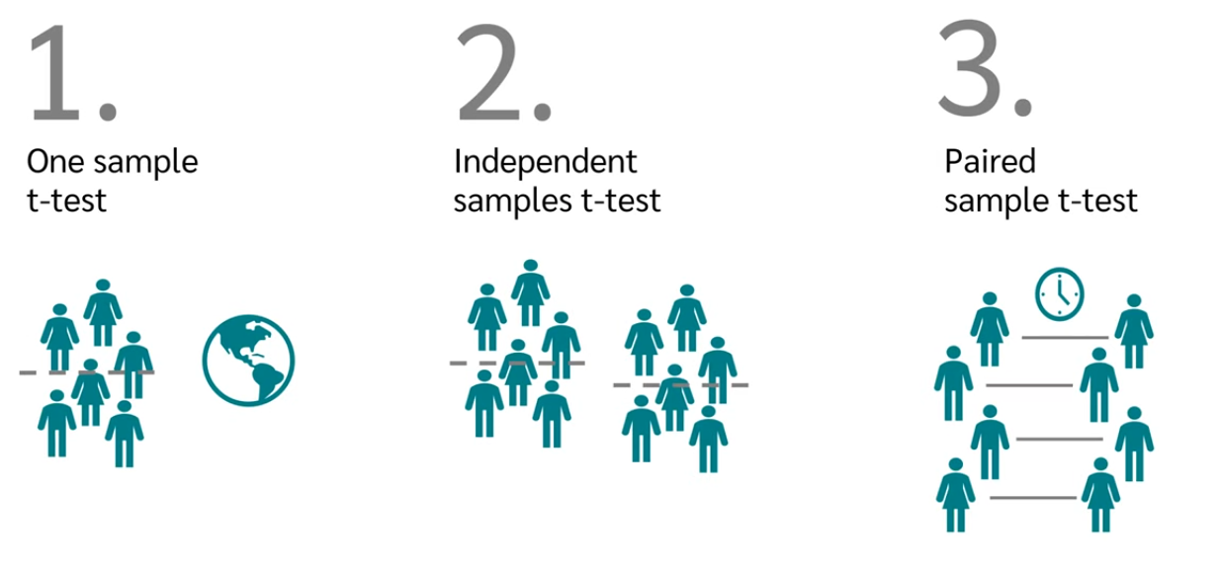
What are the assumptions for a t-test?

Slide 22
We need samples:
requirements:
two independent samples
One independent sample and a reference
A paired samples

Slide 23
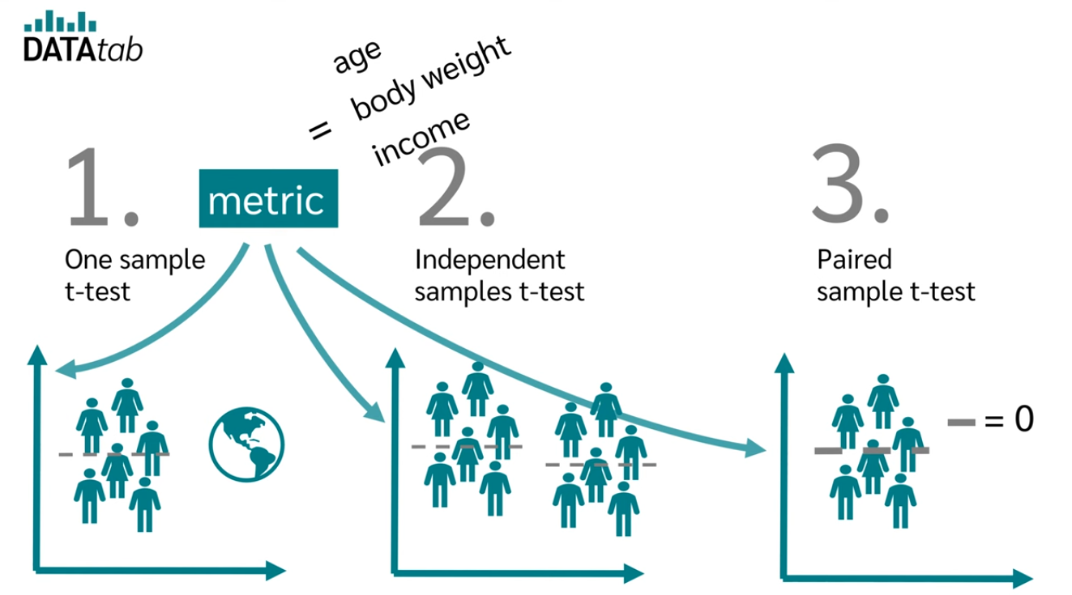
We need metric

Slide 24
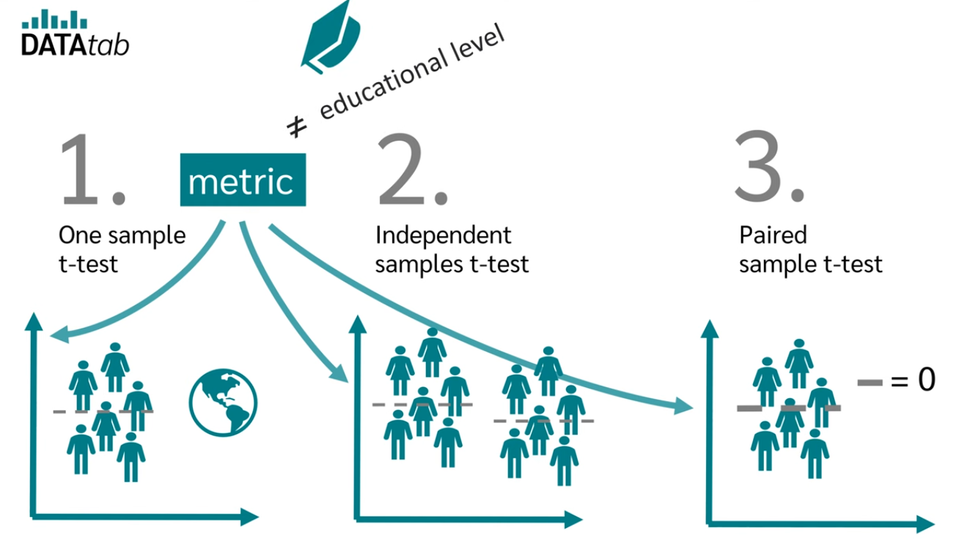
Educational level is not a metric!

Slide 25

For a t-test the data should me normal

Slide 26
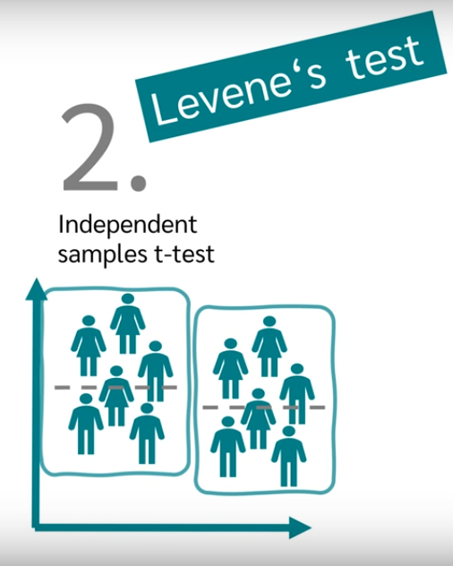
For the two independent sample test
The variance of the two groups should be independent

Slide 27
Hypotheses of the t-test

Slide 28
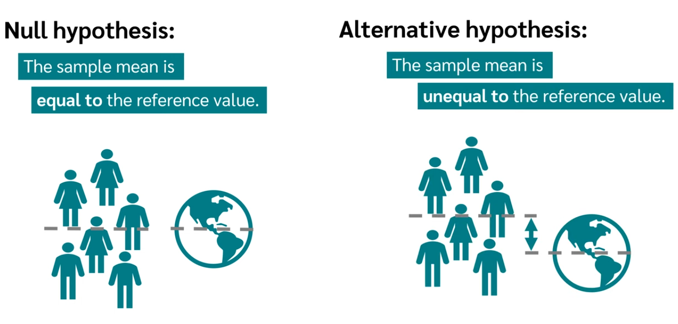
For the one sample t-test

Slide 29
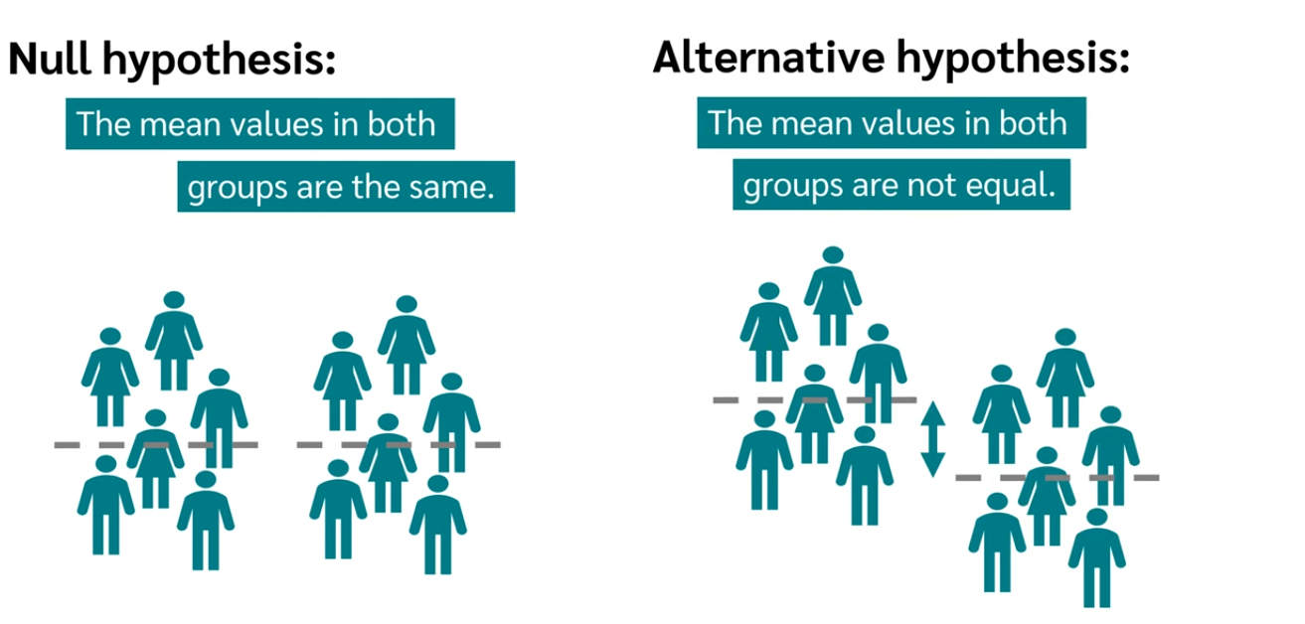
For the independent

Slide 30
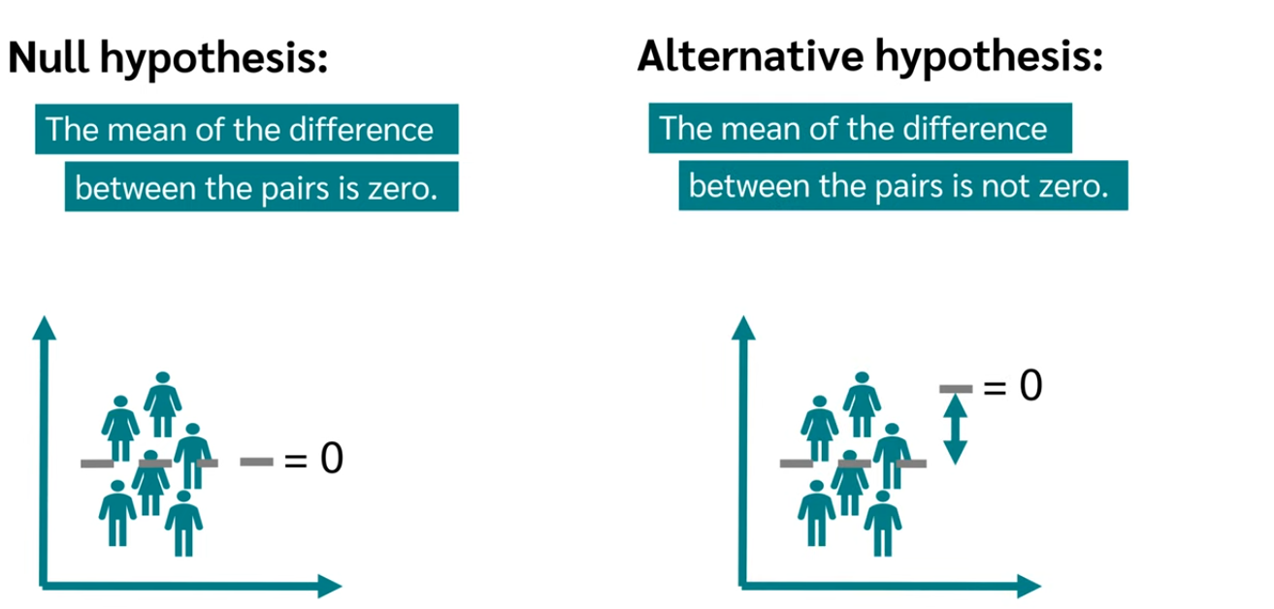
For the paired t-test

Slide 31
Why do we need a t-test?

Slide 32

Hypothesis:
Population:
There is a difference in the length of study for a Bachelor’s degree between men and women in Germany
All university graduates in Germany

Slide 33
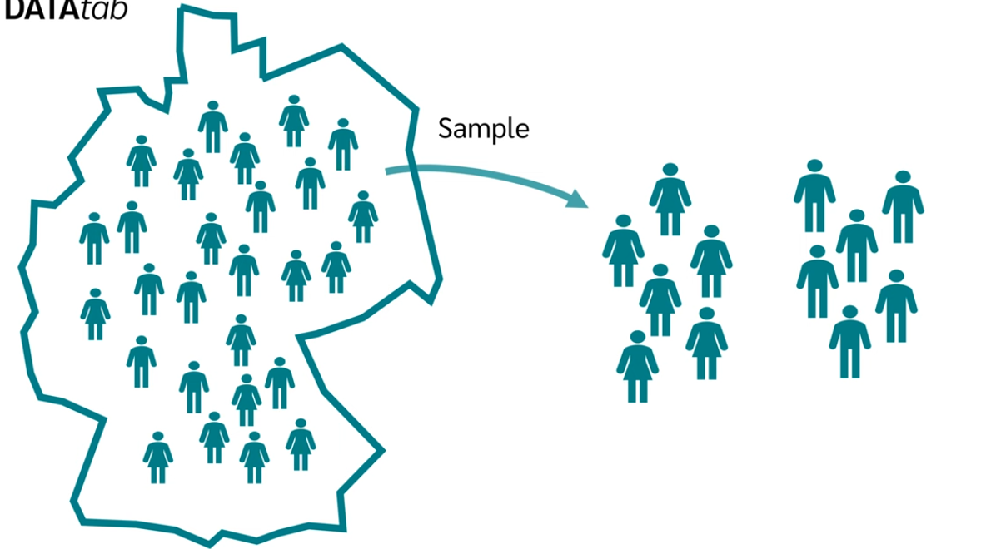
Draw a sample from the population, because we can’t test the whole population

Slide 34
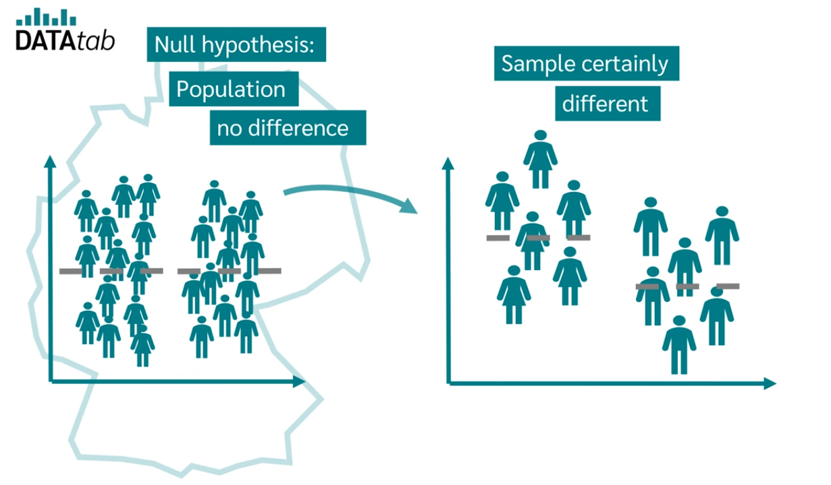
Even if there is no difference, still we would see a difference

Slide 35
And what we want to know is in what difference we would say the difference is significant

Slide 36
And this is what a t-test would do

Slide 37
How is a t-test calculated?

Slide 38
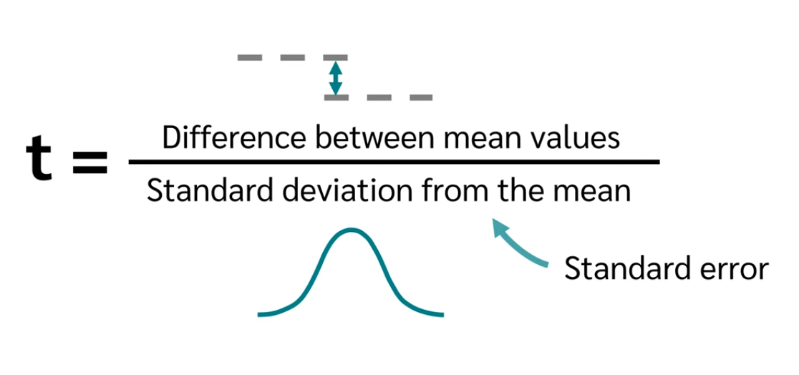

Slide 39
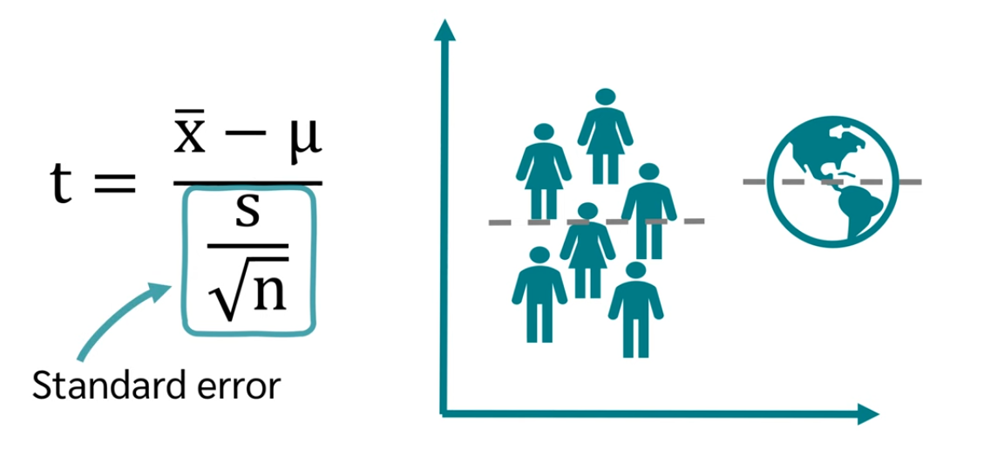
T-test for one sample t-test
Reference mean
Sample mean
Std of the sample
# of the samples

Slide 40
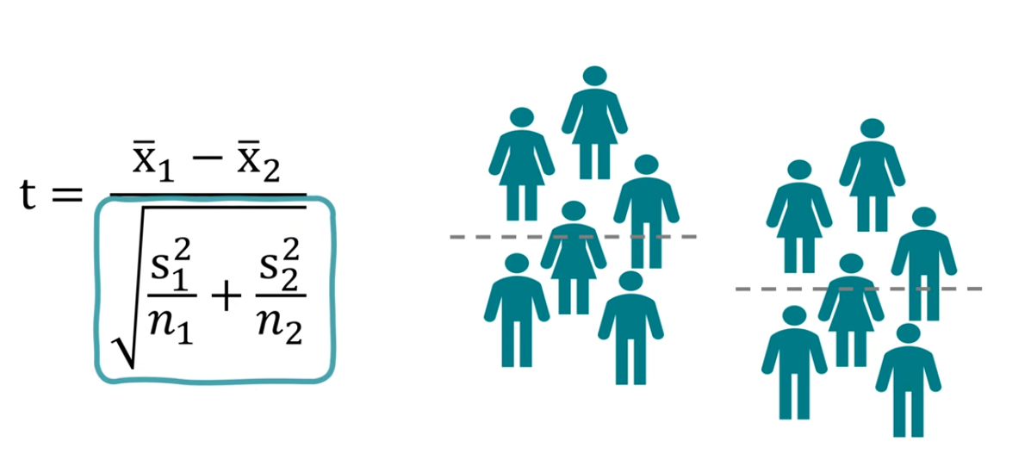
T-test for independent t-test
Dependant on equal or unequal variance, there is two different standard error relations

Slide 41
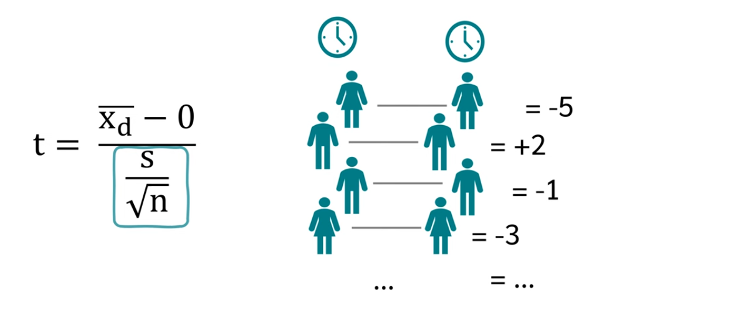
T-test for paired dataset
Mean of the differences
Same as the one sample!

Slide 42
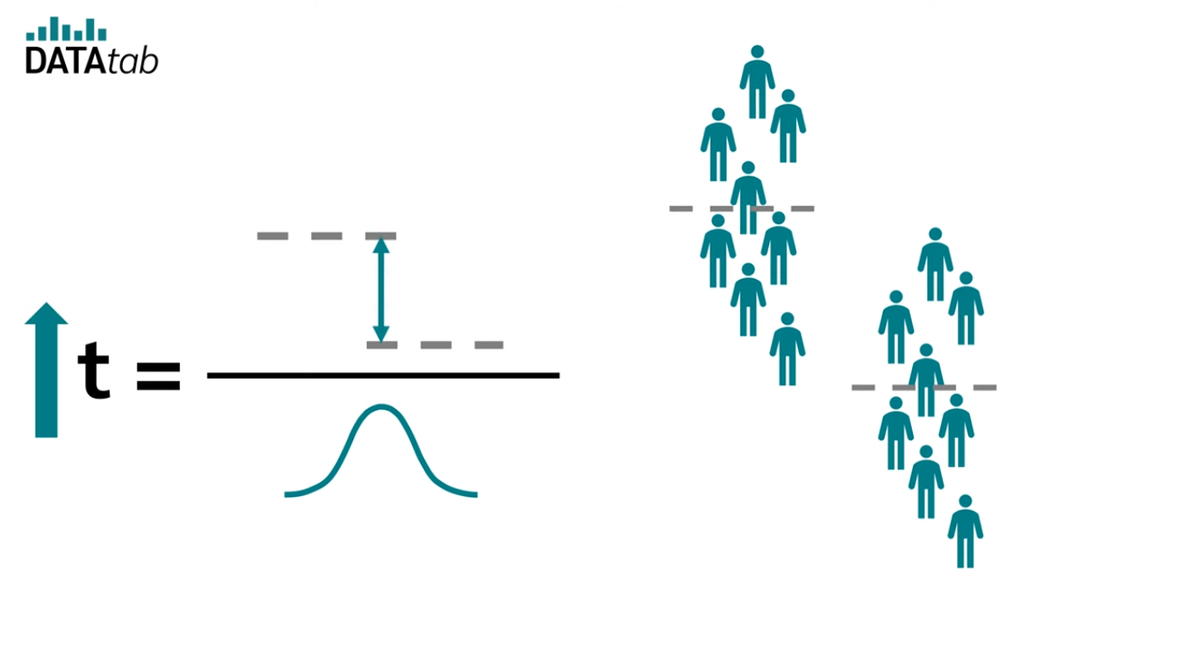
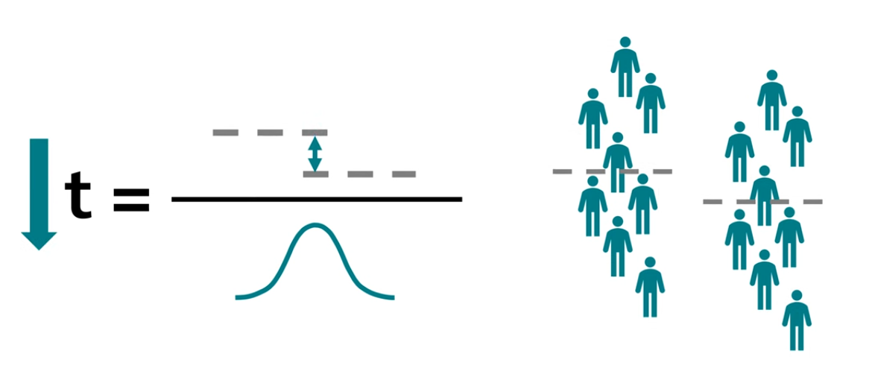
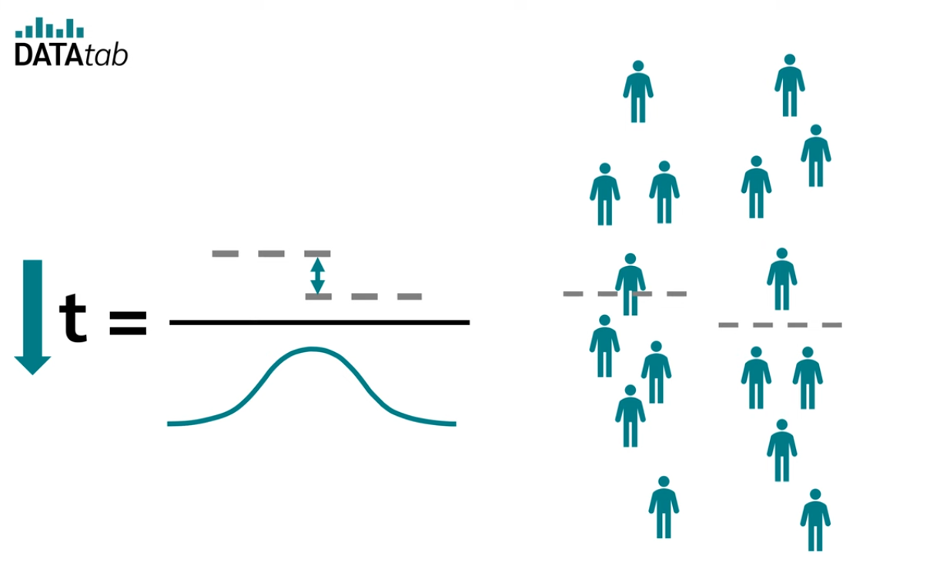
t-value?
Smaller t-value for dispersed samples

Slide 43
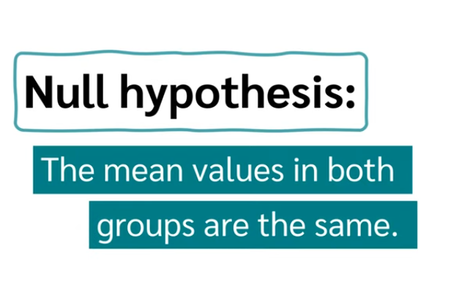


How to use it?
Reject the null
Don’t Reject the null

Slide 44
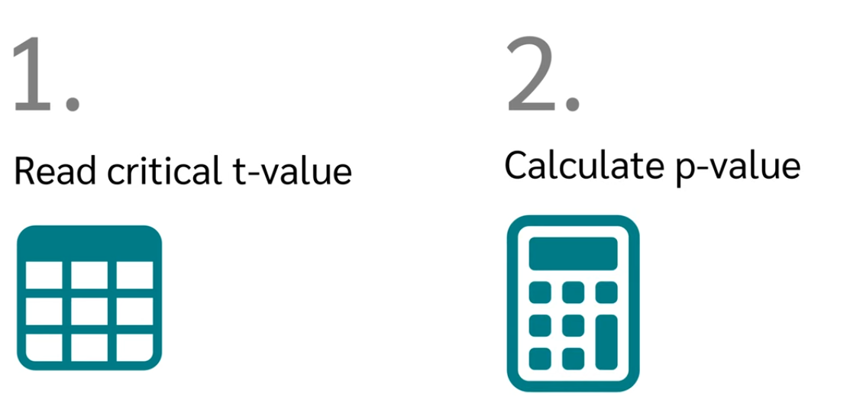

Slide 45
p-value?
How likely it is that we draw a sample and it deviates the same amount or more than the sample we drew?
The more the sample deviate from the null hypothesis the smaller the p-value becomes.

Slide 46
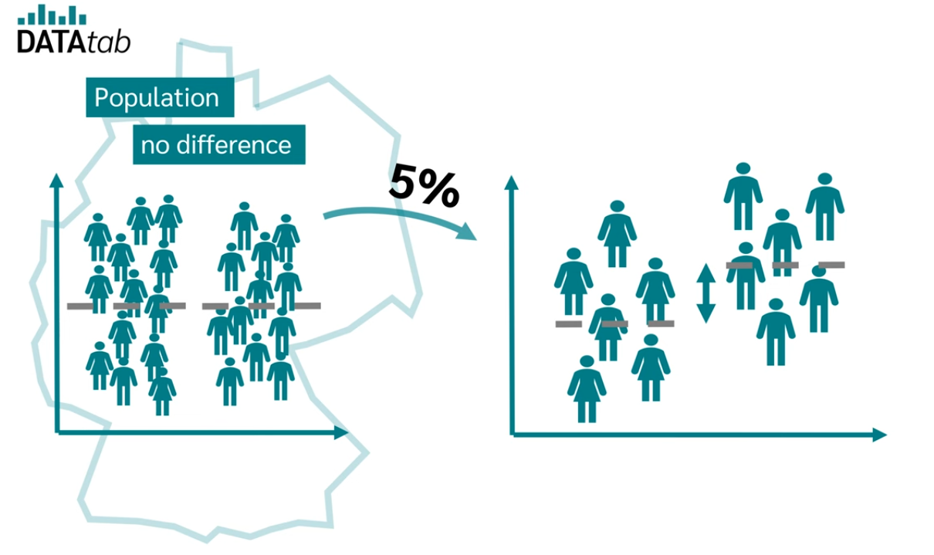
Significant level, at what deviation we would reject the null hypothesis,
If the difference is more than 5% we would reject the null hypothesis

Slide 47
p-value
Compare the p-value to the chosen significance level (α, typically 0.05):
If p <= α → reject the null hypothesis
If p > α → fail to reject the null hypothesis (insufficient evidence for the difference)

Slide 48
The p-value is calculate using the t-distribution,
It uses the calculated t-value and the df (degree of freedom),
https://datatab.net/tutorial/t-distribution

Slide 49
df
For an independent samples t-test: df = n_1 + n_2 - 2
For a paired sample t-test: df = n -1 (n is the number of the pairs)
For one sample t-test: df = n - 1 (number of samples)

Slide 50
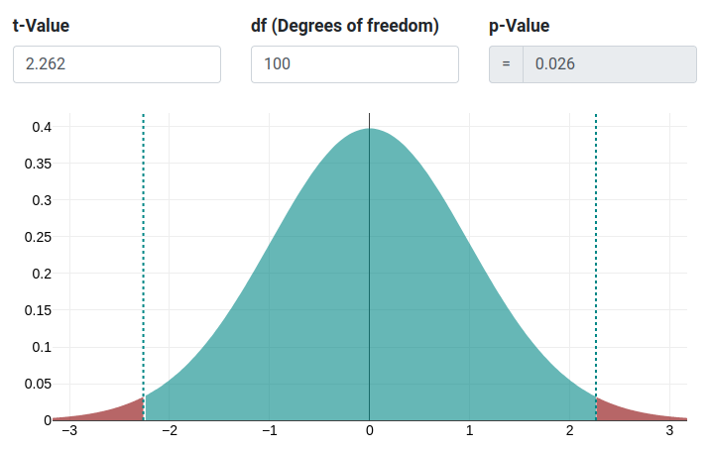
Use df and t-value to calculate the area under the t-distribution (heavy tail)
For two -tailed:
P = 2 * P(t > |t_calculated|)
For two -tailed:
P = P(t > |t_calculated|)
Or
P = P(t < |t_calculated|)
Depending on the hypothesis direction

Slide 51
one -tailed vs two-tailed
One-tailed: In a specific direction
Right-tailed
H_0 (Null): The new teaching method has no effect (or worst)
H_a (alternative): the new teaching method results in a higher scores
Left-tailed
H_0: The new drug has no effect (or is less effective)
H_a: the new drug lowers blood pressure more effectively
Two tailed: you care about the difference in either direction

